Slide 1
Presentation Databases
1-WHAT IS A DATABASE?
A database is an organized collection of structured information, or data, typically stored electronically in a computer system. A database is usually controlled by a database management system (DBMS). ... Most databases use structured query language (SQL) for writing and querying data.

Slide 2
What a Relational Database Is
A relational database is a type of database that stores and provides access to data points that are related to one another. Relational databases are based on the relational model, an intuitive, straightforward way of representing data in tables. In a relational database, each row in the table is a record with a unique ID called the key. The columns of the table hold attributes of the data, and each record usually has a value for each attribute, making it easy to establish the relationships among data points.

Slide 3
How Relational Databases Are Structured
The relational model means that the logical data structures—the data tables, views, and indexes—are separate from the physical storage structures. This separation means that database administrators can manage physical data storage without affecting access to that data as a logical structure. For example, renaming a database file does not rename the tables stored within it.
The distinction between logical and physical also applies to database operations, which are clearly defined actions that enable applications to manipulate the data and structures of the database. Logical operations allow an application to specify the content it needs, and physical operations determine how that data should be accessed and then carries out the task.
To ensure that data is always accurate and accessible, relational databases follow certain integrity rules. For example, an integrity rule can specify that duplicate rows are not allowed in a table in order to eliminate the potential for erroneous information entering the database.

Slide 4
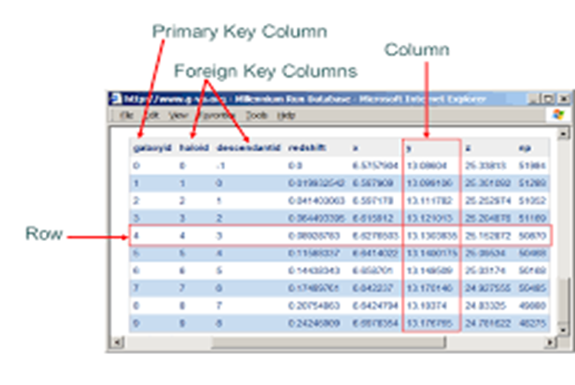
TABLES: ROWS AND COLUMNS
In computer science terminology, rows are sometimes called "tuples," columns may be referred to as "attributes," and the tables themselves may be called "relations." A table can be visualized as a matrix of rows and columns, where each intersection of a row and column contains a specific value

Slide 5
WHAT IS A RELATIONAL DATABASE MANAGEMENT SYSTEM (RDBMS)?
A relational database management system (RDBMS) is a program that allows you to create, update, and administer a relational database. Most relational database management systems use the SQL language to access the database.

Slide 6

SQL
SQL is a standard language for accessing and manipulating databases.
SQL stands for Structured Query Language
SQL lets you access and manipulate databases
SQL became a standard of the American National Standards Institute (ANSI) in 1986, and of the International Organization for Standardization (ISO) in 1987
What Can SQL do?
SQL can execute queries against a database
SQL can retrieve data from a database
SQL can insert records in a database
SQL can update records in a database
SQL can delete records from a database
SQL can create new databases
SQL can create new tables in a database
SQL can create stored procedures in a database
SQL can create views in a database
SQL can set permissions on tables, procedures, and views

Slide 7
what is My SQL
MySQL ( "My S-Q-L")[5] is an open-source relational database management system (RDBMS).[5][6] Its name is a combination of "My", the name of co-founder Michael Widenius's daughter,[7] and "SQL", the abbreviation for Structured Query Language. A relational database organizes data into one or more data tables in which data types may be related to each other; these relations help structure the data. SQL is a language programmers use to create, modify and extract data from the relational database, as well as control user access to the database. In addition to relational databases and SQL, an RDBMS like MySQL works with an operating system to implement a relational database in a computer's storage system, manages users, allows for network access and facilitates testing database integrity and creation of backups.
MySQL is free and open-source software under the terms of the GNU General Public License, and is also available under a variety of proprietary licenses. MySQL was owned and sponsored by the Swedish company MySQL AB, which was bought by Sun Microsystems (now Oracle Corporation).[8] In 2010, when Oracle acquired Sun, Widenius forked the open-source MySQL project to create MariaDB.[9]
MySQL has stand-alone clients that allow users to interact directly with a MySQL database using SQL, but more often MySQL is used with other programs to implement applications that need relational database capability. MySQL is a component of the LAMP web application software stack (and others), which is an acronym for Linux, Apache, MySQL, Perl/PHP/Python. MySQL is used by many database-driven web applications, including Drupal, Joomla, phpBB, and WordPress. MySQL is also used by many popular websites, including Facebook,[10][11] Flickr,[12] MediaWiki,[13] Twitter,[14] and YouTube.[15]

Slide 8
What is PostgreSQL
PostgreSQLalso known as Postgres, is a free and open-source relational database management system (RDBMS) emphasizing extensibility and SQL compliance. It was originally named POSTGRES, referring to its origins as a successor to the Ingres database developed at the University of California, Berkeley.[13][14] In 1996, the project was renamed to PostgreSQL to reflect its support for SQL. After a review in 2007, the development team decided to keep the name PostgreSQL and the alias Postgres.[15]
PostgreSQL features transactions with Atomicity, Consistency, Isolation, Durability (ACID) properties, automatically updatable views, materialized views, triggers, foreign keys, and stored procedures.[16] It is designed to handle a range of workloads, from single machines to data warehouses or Web services with many concurrent users. It is the default database for macOS Server,[17][18][19] and is also available for Linux, FreeBSD, OpenBSD, and Windows.

Slide 9
What is Oracle Database
Oracle Database (commonly referred to as Oracle DBMS or simply as Oracle) is a multi-model^{[4]} database management system produced and marketed by Oracle Corporation.
It is a database commonly used for running online transaction processing (OLTP), data warehousing (DW) and mixed (OLTP & DW) database workloads. Oracle Database is available by serveral service providers on-prem, on-cloud, or as hybrid cloud installation. It may be run on third party servers as well as on Oracle hardware (Exadata on-prem, on Oracle Cloud or at Cloud at Customer ^{[5]}). Exclusively for Cloud customers Oracle offers Oracle Autonomous Database ^{[6]} providing fully automated operation procedures.

Slide 10
What is SQL Server
SQL Server may refer to:
Any database server that implements the structured query language (SQL)
Microsoft SQL Server, a relational database server from Microsoft
Sybase SQL Server, a relational database server developed by Sybase
SQL Server (magazine), a trade publication and web site owned by Penton Media

Slide 11
What is SQLite
is a relational database management system (RDBMS) contained in a C library. In contrast to many other database management systems, SQLite is not a client–server database engine. Rather, it is embedded into the end program.
SQLite is ACID-compliant and implements most of the SQL standard, generally following PostgreSQL syntax. However, SQLite uses a dynamically and weakly typed SQL syntax that does not guarantee the domain integrity. This means that one can, for example, insert a string into a column defined as an integer. SQLite will attempt to convert data between formats where appropriate, the string "123" into an integer in this case, but does not guarantee such conversions and will store the data as-is if such a conversion is not possible.
SQLite is a popular choice as embedded database software for local/client storage in application software such as web browsers. It is arguably the most widely deployed database engine, as it is used today by several widespread browsers, operating systems, and embedded systems (such as mobile phones), among othersSQLite has bindings to many programming languages.

